Slide 1
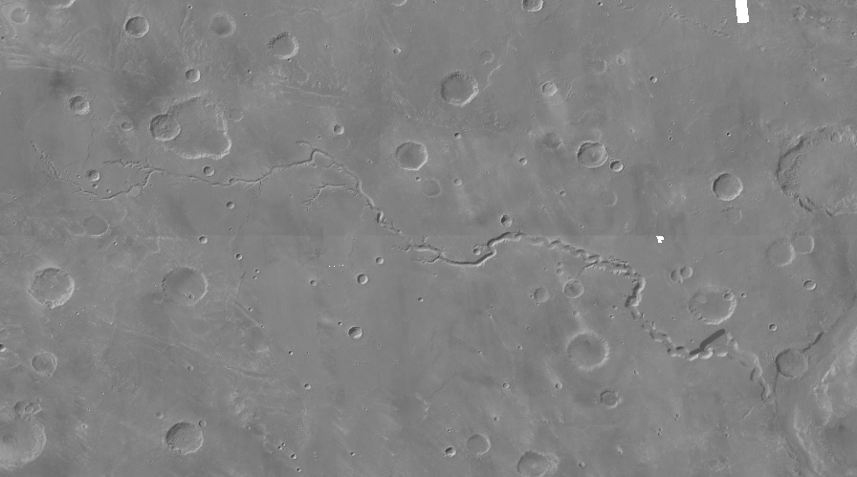
Segmentation of fluvial channels on Mars
Final project for “Practical Deep Learning for Science” course
August 2021
Nathan Wainstein & Elad David
Department of Earth and Planetary Sciences
Weizmann Institute of Science
Notes:
Data Mining and Processing
Deep Learning – Segmentation
Results
Conclusion

Slide 2
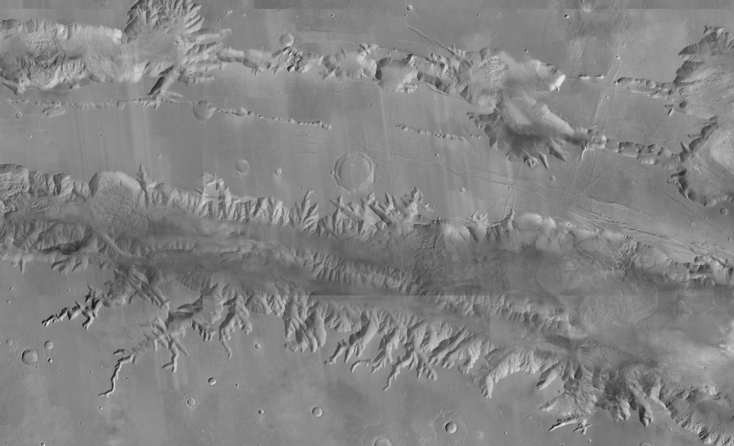
Data Mining and Processing
Images –
Mars rendered at 5.0 m/px using Context Camera (CTX) data from the Mars Reconnaissance Orbiter (MRO).
True Masks –
ArcGIS polyline layer of marked valleys on Mars (Alemanno & Orofino, 2017)
Creating the dataset –
Using the arcpy library for Python, we automatically obtained images and corresponding masks for 3772 valley sites.
Post-processing –
In Matlab, change black to white and binarize
Notes:
Talk about:
Vectorizes polylines layer to snaps (rasterian) = mask and processing/generating with Matlab, a binarized masks of the snapped valleys route markers

Slide 3
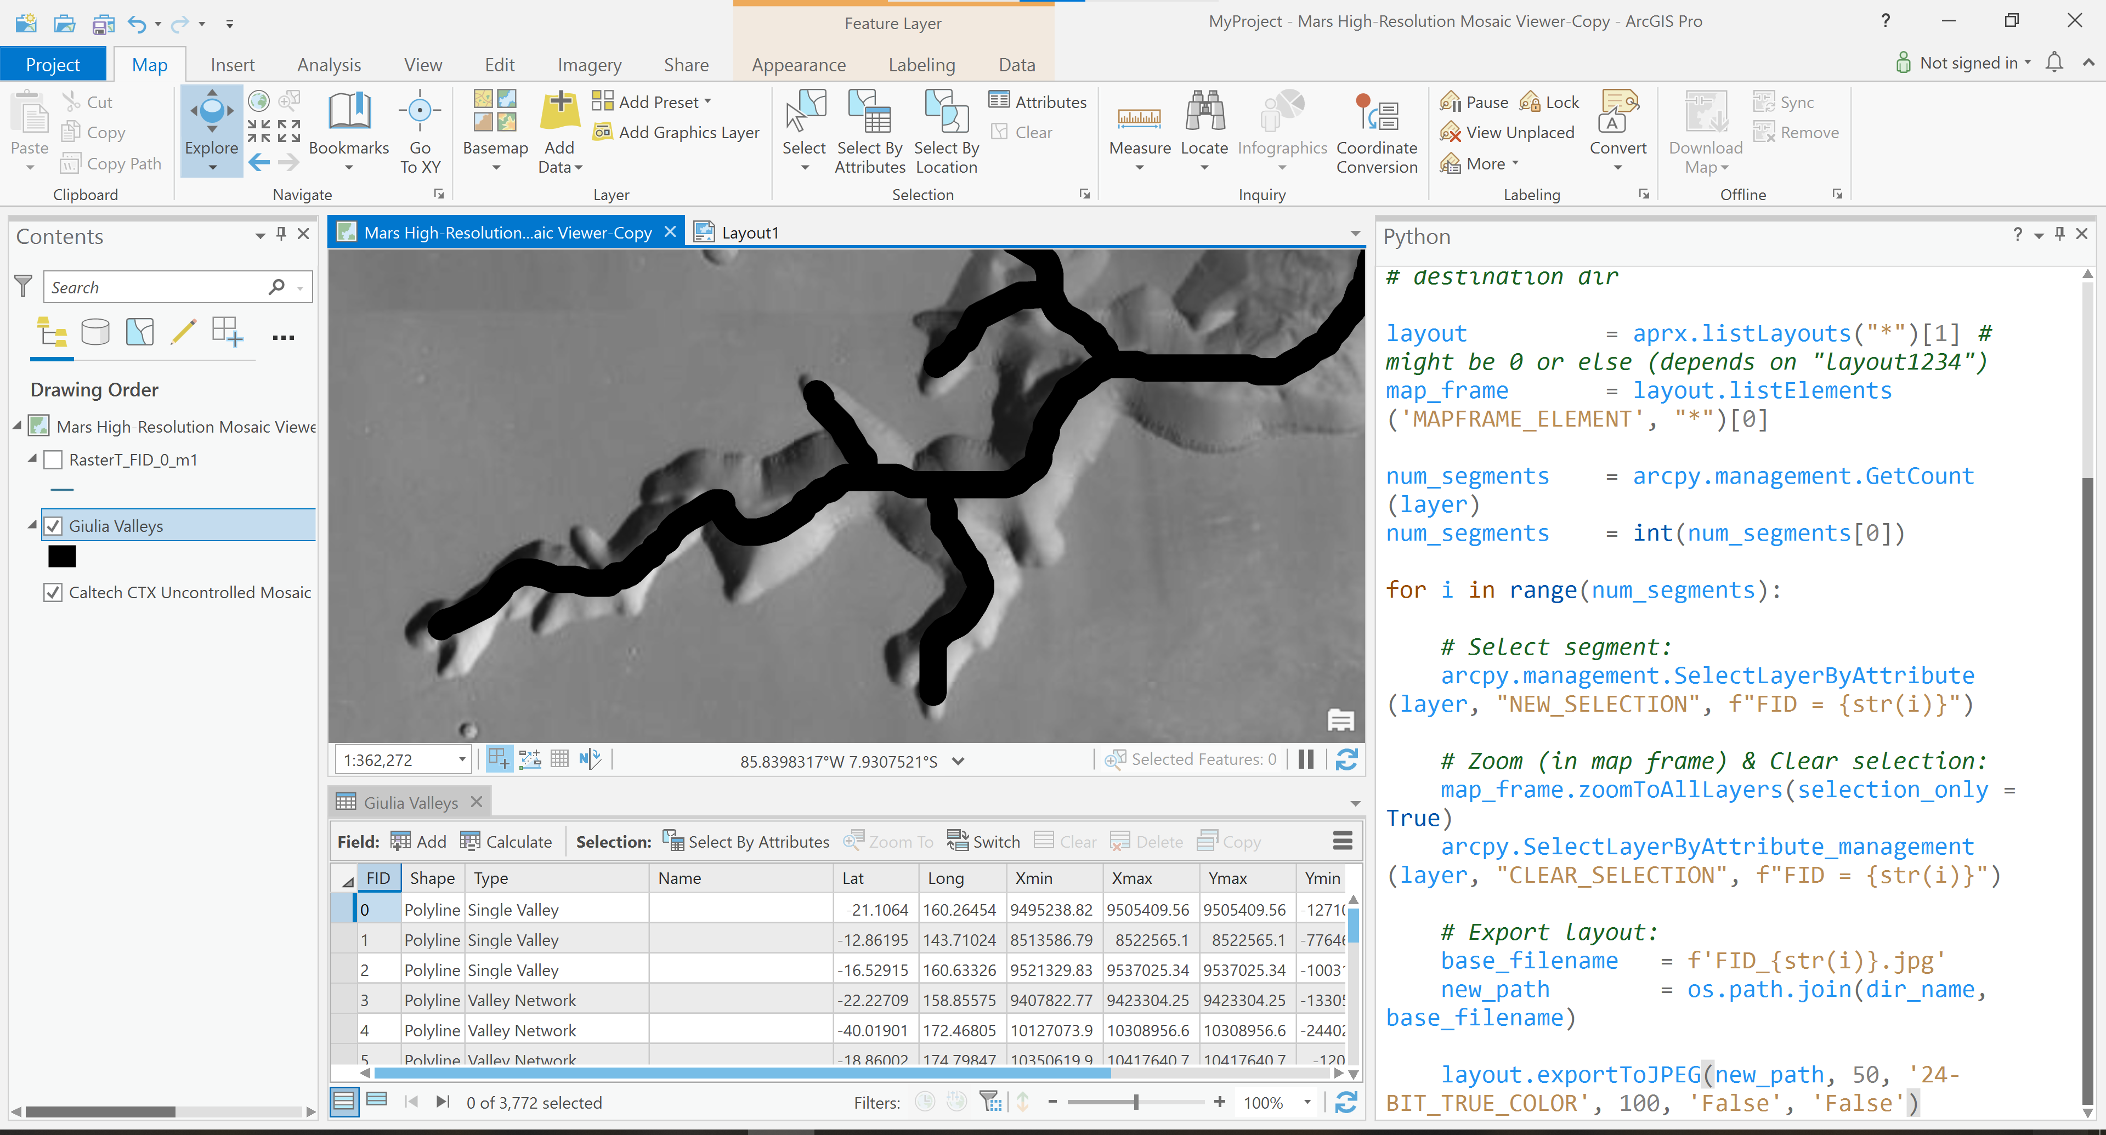
Data Mining and Processing
Notes:
Talk about:
Vectorizes polylines layer to snaps (rasterian) = mask and processing/generating with Matlab, a binarized masks of the snapped valleys route markers

Slide 4
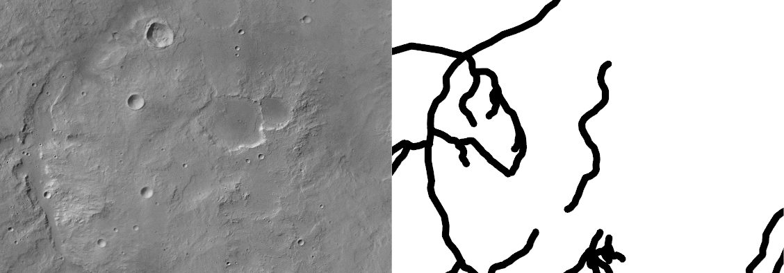
Data Mining and Processing
Notes:
Talk about:
Vectorizes polylines layer to snaps (rasterian) = mask and processing/generating with Matlab, a binarized masks of the snapped valleys route markers

Slide 5

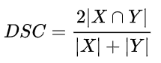
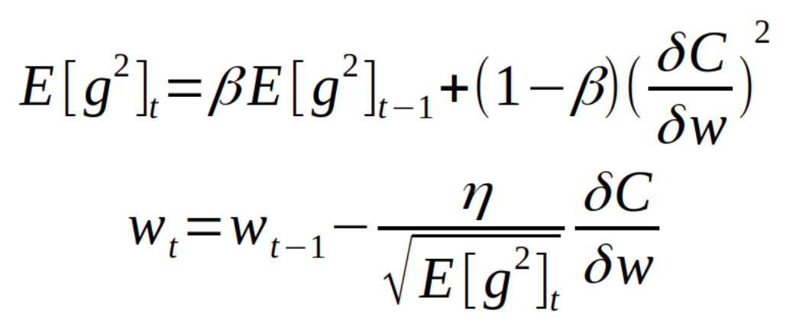
Segmentation with U-Net
Dice loss (= 1-DSC) for accuracy estimation
RMSprop for optimization (weight decay 10^-8, momentum 0.9)
U-Net: Convolutional Networks for Biomedical Image Segmentation; Olaf Ronneberger, Philipp Fischer, Thomas Brox

Slide 6
Default run
Dataset size: 3772 images
Downscaling factor: 0.5
Learning rate: 0.0001
90% training, 10% validation
5 epochs (full dataset per epoch)

Slide 7
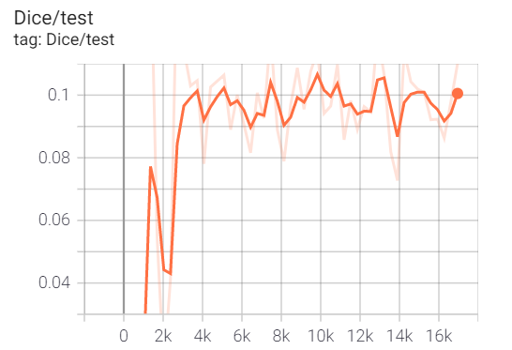
Default run
Dataset size: 3772 images
Downscaling factor: 0.5
Learning rate: 0.0001
90% training, 10% validation
5 epochs (full dataset per epoch)
Result:
Dice = 0.1

Slide 8
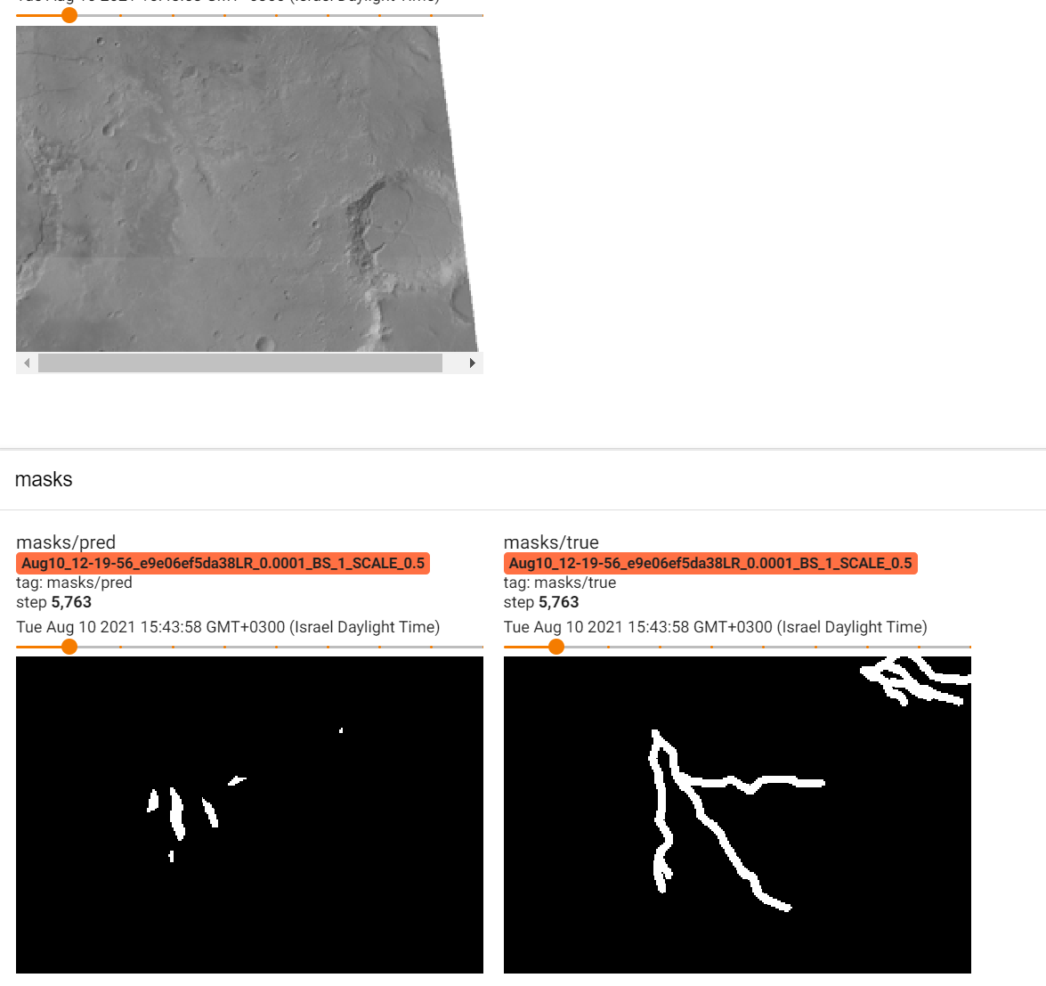
Default run

Slide 9
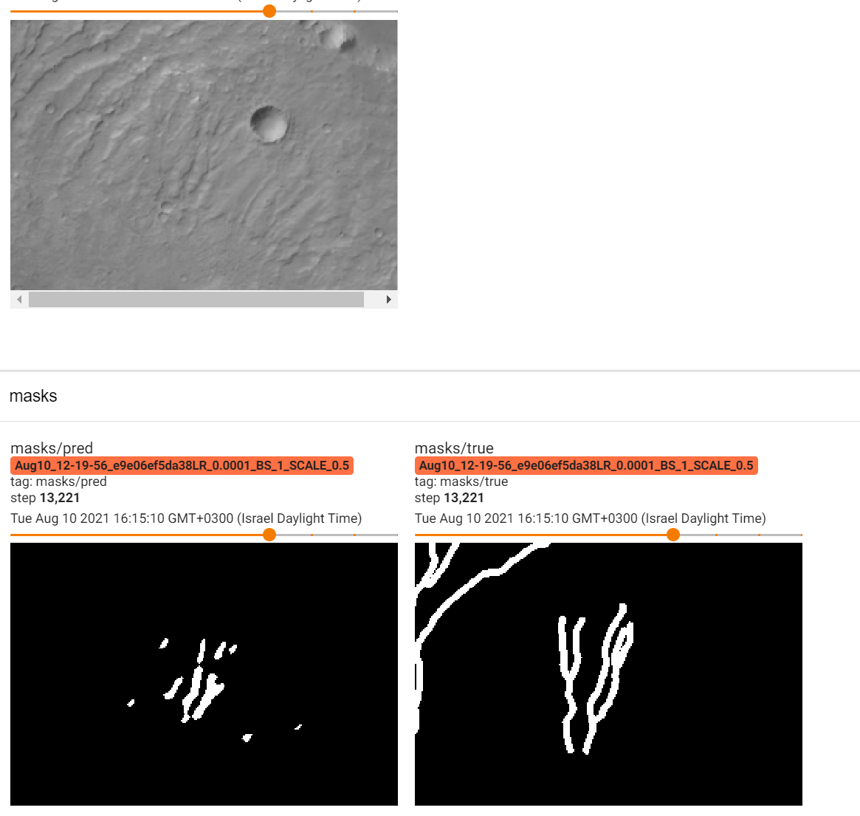
Default run

Slide 10
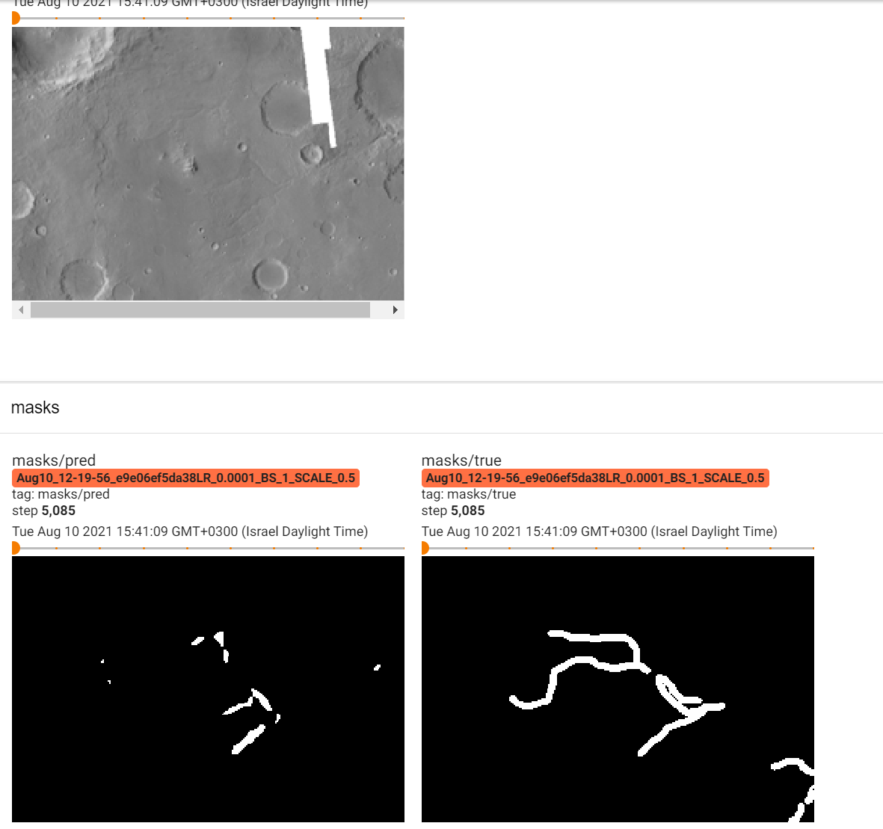
Default run

Slide 11
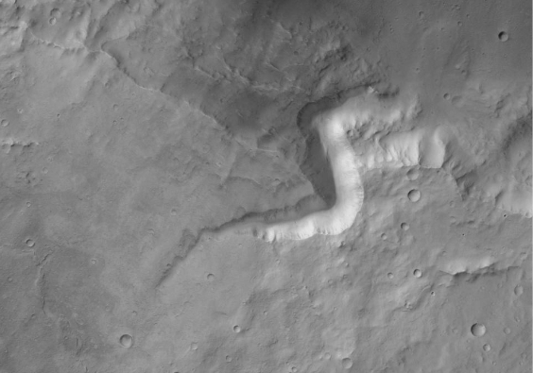

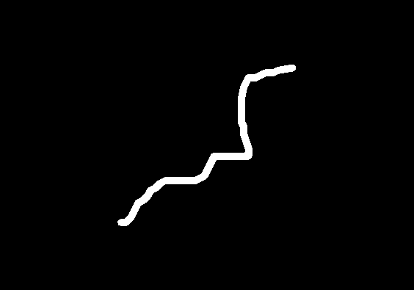
Default run

Slide 12
Change downscaling factor
Dataset size: 3772 images
Downscaling factor: 0.25, 0.75, 1
Learning rate: 10^-4s
90% training, 10% validation
5 epochs (full dataset per epoch)

Slide 13
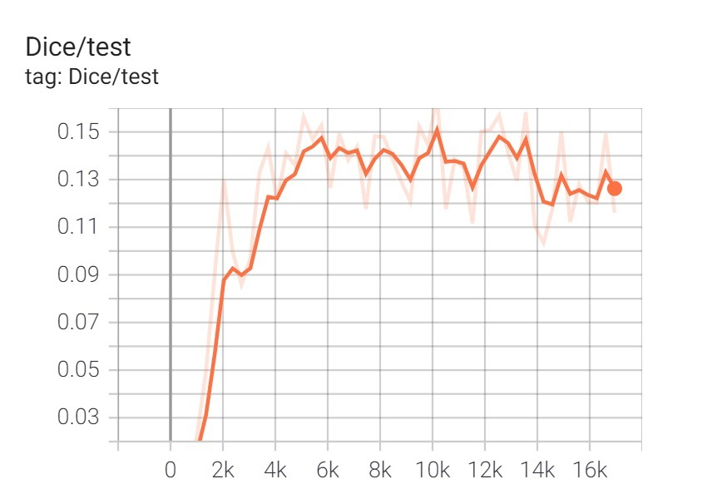
Change downscaling factor
Dataset size: 3772 images
Downscaling factor: 0.25, 0.75, 1
Learning rate: 10^-4s
90% training, 10% validation
5 epochs (full dataset per epoch)
Results:
DF = 0.25 → Dice = 0.14
DF = 0.75 → Dice = 0.06
DF = 1 → Dice = 0.05

Slide 14
Change learning rate
Dataset size: 3772 images
Downscaling factor: 0.5
Learning rate: 0.01, 10^-5, 10^-6
90% training, 10% validation
5 epochs (full dataset per epoch)

Slide 15
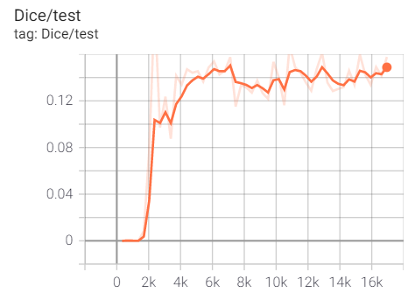
Change learning rate
Dataset size: 3772 images
Downscaling factor: 0.5
Learning rate: 0.01, 10^-5, 10^-6
90% training, 10% validation
5 epochs (full dataset per epoch)
Results:
LR = 0.01 → Dice = 10^-8 (no convergence)
LR = 10^-5 → Dice = 0.14
LR = 10^-6 → Dice = 0.14

Slide 16
Change learning rate & downscaling factor
Dataset size: 3772 images
Downscaling factor: 0.25
Learning rate: 10^-5
90% training, 10% validation
5 epochs (full dataset per epoch)

Slide 17
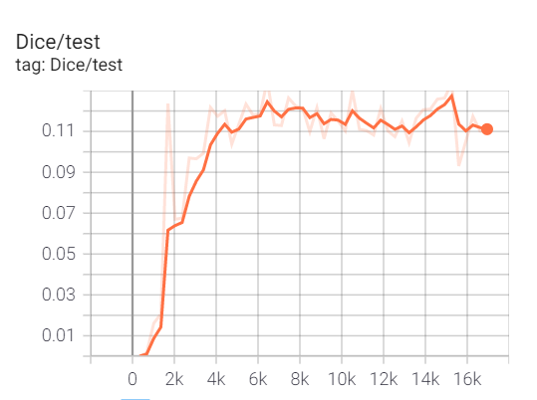
Change learning rate & downscaling factor
Dataset size: 3772 images
Downscaling factor: 0.25
Learning rate: 10^-5
90% training, 10% validation
5 epochs (full dataset per epoch)
Result:
Dice = 0.12 (no improvement over individual modifications)

Slide 18
Some more examples…

Slide 19
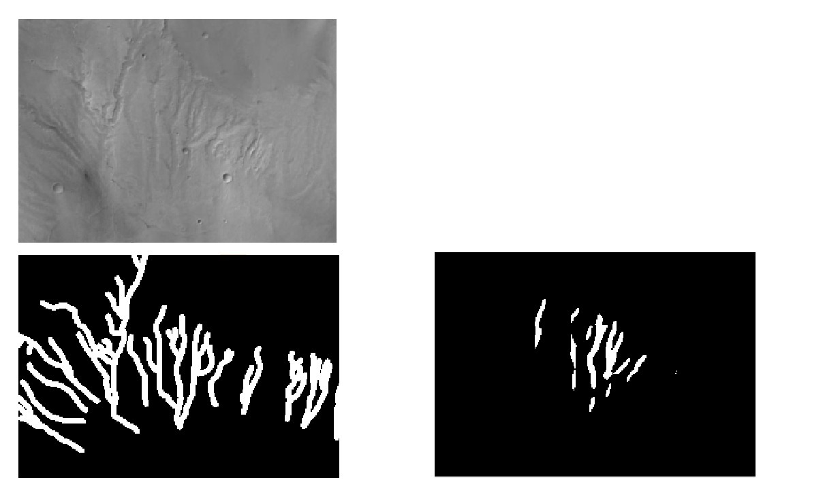
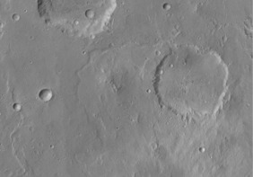
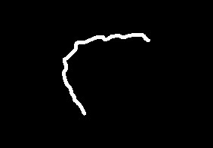

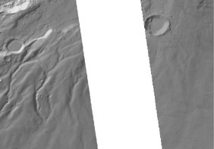
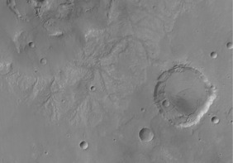
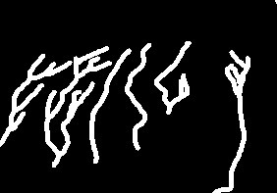

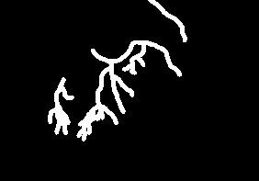
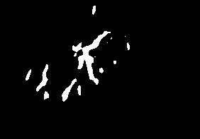

Slide 20
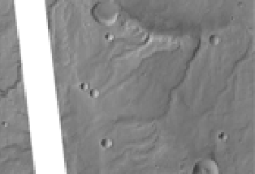
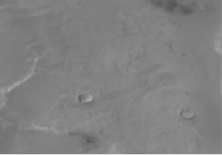

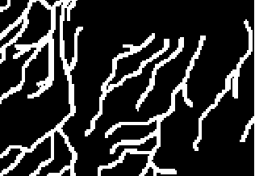
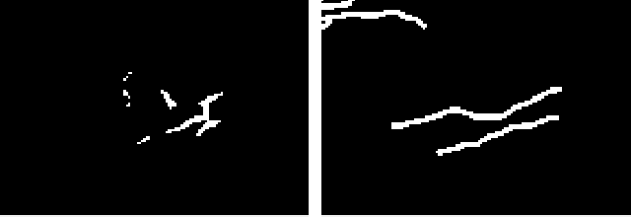
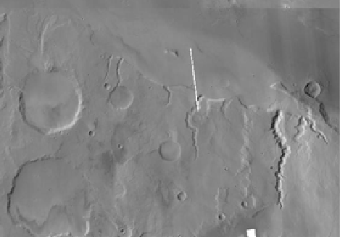
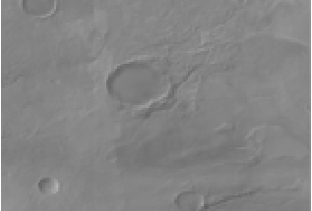

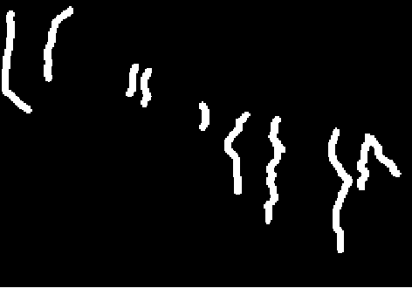
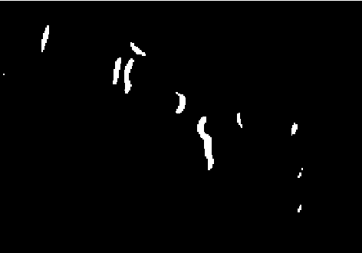

Slide 21
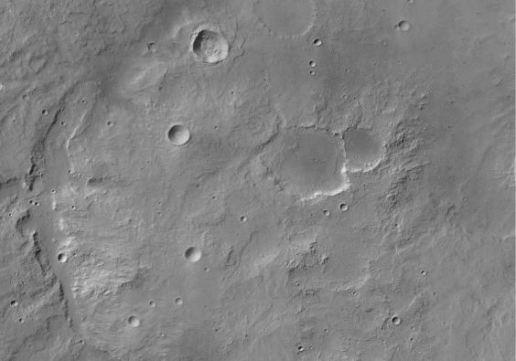
Augmentation
Dataset size: 30176 images (8 rotations per image)/11316 images (3 rotations per image) – divided to 3772 per epoch
Downscaling factor: 0.25
Learning rate: 10^-5
90% training, 10% validation
5 epochs

Slide 22
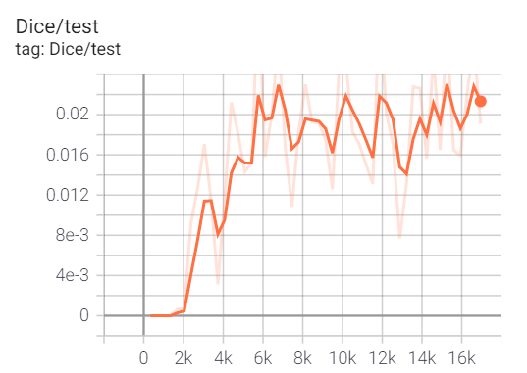
Augmentation
Dataset size: 30176 images (8 rotations per image)/11316 images (3 rotations per image) – divided to 3772 per epoch
Downscaling factor: 0.25
Learning rate: 10^-5
90% training, 10% validation
5 epochs
Result:
8 rotations → Dice = 10^-7 (no convergence)
3 rotations → Dice = 0.02

Slide 23
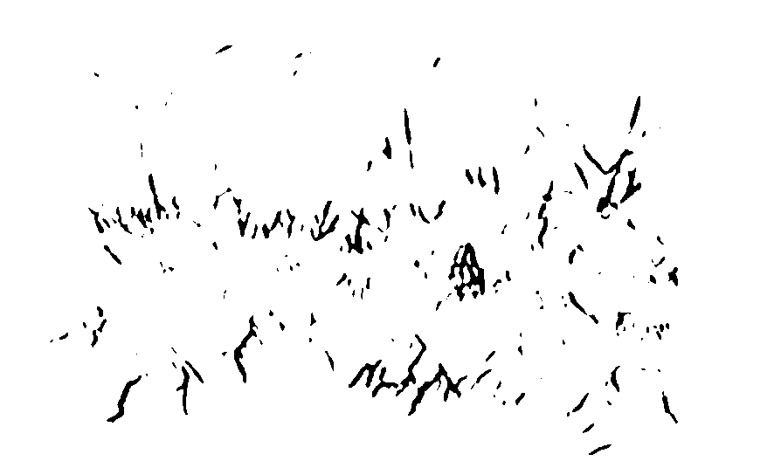

Slide 24
Conclusions
The deep network achieved a reasonable result –
recognizes wide channels with high contrast against background, avoids craters, etc.
The main problem: the dataset is challenging –
huge variety of geomorphologies, all marked with the same label.
Improving performance –
(successful) augmentation, better preprocessing, using pretrained models (e.g., trained on arid environment river channels on Earth), transfer learning
Notes:
1. We think that the DICE will be higher if we improve the masks and maybe the pre-processing of the images.
2.

